Slide 1
JavaScript - Fundamentals

Slide 2
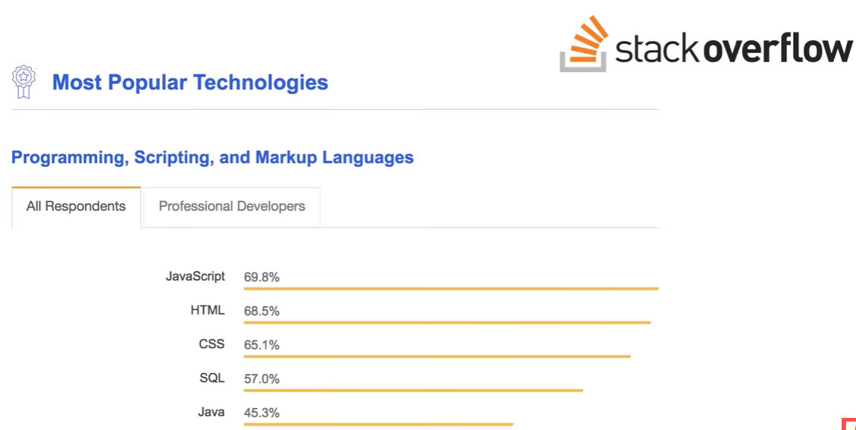
What is JavaScript?
  JavaScript is the most widely used programming language in the world
  Big companies like Netflix, Walmart and PayPal develop internet applications using JavaScript

Slide 3
What can you do with JavaScript?
  For long time, It is used to develop interactive website
  Full blown mobile and web applications are developed using JavaScript
Where does JS code runs?
  JS code originally designed to run only in Browser. In browser, there is JS Engine.
  A JavaScript engine is a program that reads JavaScript code and executes it.
Different browsers have different JavaScript engines:
  Google Chrome → V8
  Mozilla Firefox → SpiderMonkey
  Safari → JavaScriptCore
  Microsoft Edge → V8 (modern versions)

Slide 4
V8 before Node.js (2008)
Google developed V8 as the JavaScript engine for the Chrome browser.
Its job was simply to:
Parse JavaScript code.
Compile it to machine code (JIT compilation).
Execute the code very quickly.
Manage memory using garbage collection.
However, V8 knew nothing about the operating system.
It could not:
Read or write files.
Open network sockets.
Create an HTTP server.
Access databases.
Execute operating system commands.
Read directories.
These are not JavaScript language features.
Ryan Dahl embedded the V8 JavaScript engine in 2009, into a new runtime and added APIs and infrastructure that allowed JavaScript to interact with the operating system.

Slide 5
ECMA stands for European Computer Manufacturers Association.
Why is ECMA important to JavaScript?
JavaScript was originally created by Brendan Eich at Netscape in 1995. As JavaScript became popular, there was a need for a standard version so that all browsers would implement the language consistently.
In 1996, Netscape submitted JavaScript to ECMA for standardization.
In 1997, ECMA published the first standard called ECMAScript (ECMA-262).
So,
→ JavaScript → Programming language used by developers.
→ ECMAScript (ES) → The official specification (standard) that defines how JavaScript should work.

Slide 6
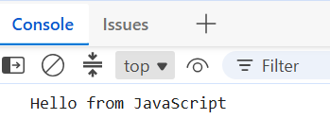
Ways in which scripts can be added
Embedded Script - Write the JavaScript directly inside a <script> tag.
<!DOCTYPE html>
<html>
<head>
<script>
console.log("Hello from JavaScript");
</script>
</head>
<body>
<h1>My Website</h1>
</body>
</html>

Slide 7
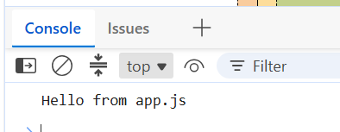
External JavaScript (Recommended)
Store the JavaScript in a separate .js file.
<!DOCTYPE html>
<html>
<head>
<script src="app.js"></script>
</head>
<body>
<h1>My Website</h1>
</body>
</html>
app.js
console.log("Hello from app.js");

Slide 8
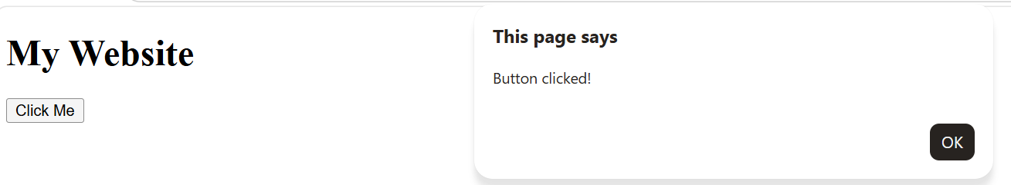
Inline JavaScript
Write JavaScript directly in an HTML element's attribute.
<!DOCTYPE html>
<html>
<head>
<script src="app.js"></script>
</head>
<body>
<h1>My Website</h1>
<button onclick="alert('Button clicked!')">
Click Me
</button>
</body>
</html>

Slide 9
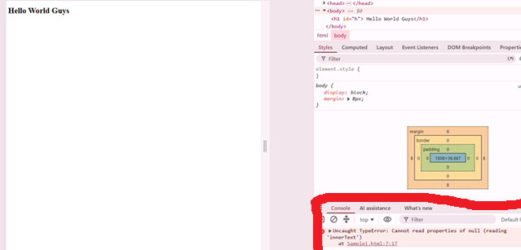
Effect of Embedded Script
Script reads null , as DOM is not rendered
<!Doctype HTML>
<html>
<head>
<script>
let k=document.getElementById("h");
console.log(k.innerText);
</script>
</head>
<body>
<h1 id="h"> Hello World Guys</h1>
</body>
</html>

Slide 10
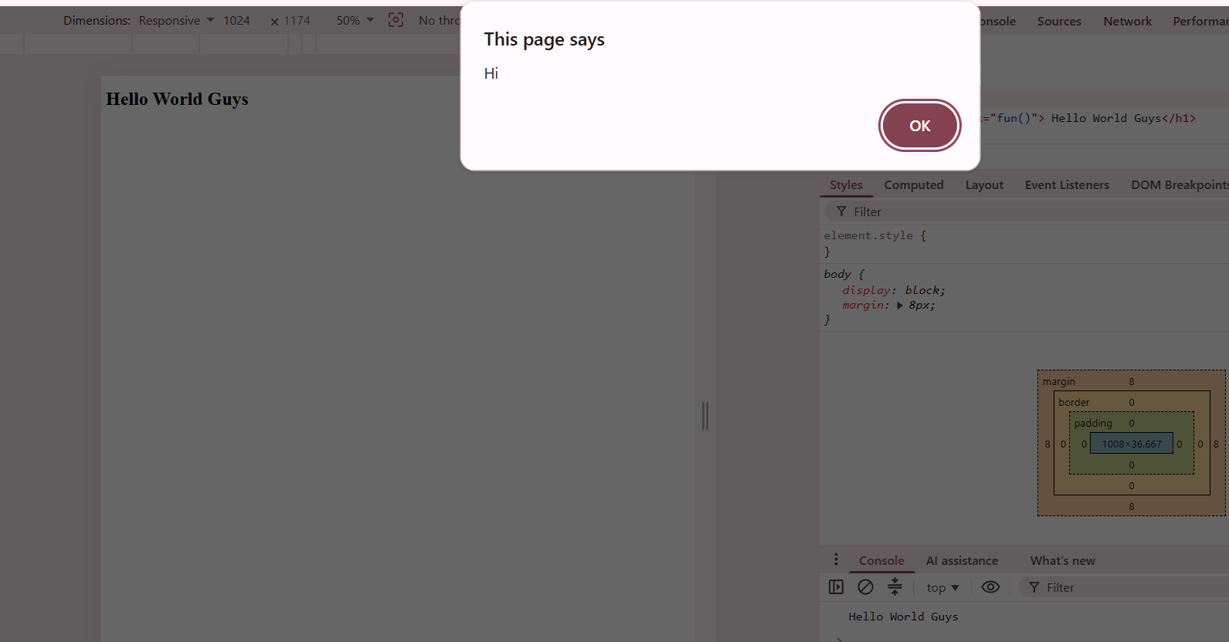
Effect of Embedded Script
Script reads the value “Hello World Guys” , as script is applied after the DOM is rendered
<!Doctype HTML>
<html>
<head>
<script>
function fun(){
let k=document.getElementById("h");
console.log(k.innerText);
alert("Hi");
}
</script>
</head>
<body>
<h1 id="h" onclick="fun()"> Hello World Guys</h1>
</body>
</html>

Slide 11
Effect of External Script with defer attribute
Script reads the value “Hello World Guys” , as script is applied after the DOM is rendered
<!Doctype HTML>
<html>
<head>
<script src="defer.js" defer></script>
</head>
<body>
<h1 id="h"> Hello World Guys</h1>
</body>
</html>
defer.js
let k=document.getElementById("h");
console.log(k.innerText);

Slide 12
Async and defer attributes
async and defer attributes in JavaScript are used to control how external scripts are loaded and executed in an HTML document.
The defer attribute also downloads the script in parallel with HTML parsing.
However, the execution of the script is deferred until the entire HTML document is fully parsed. This ensures that scripts are executed in the order they appear in the document.
Both attributes improve page performance by allowing scripts to load without blocking HTML parsing, but they differ in their execution behavior.
The async attribute allows the script to be downloaded in parallel with HTML parsing.
Once the script is downloaded, it is executed immediately, pausing the HTML parsing process.
This means async scripts do not wait for other scripts or the DOM to finish loading.

Slide 13
Async and defer attributes
Key Differences
Execution Timing: async scripts execute as soon as they are downloaded, while defer scripts wait until HTML parsing is complete.
Order of Execution: async scripts may execute out of order, depending on download completion. defer scripts maintain their order of appearance in the document.
Use Cases: Use async for independent scripts and defer for scripts that rely on the DOM or need to maintain execution order.
Practical Considerations
For optimal performance:
Use async for scripts that do not depend on other scripts or the DOM.
Use defer for scripts that require the DOM to be fully parsed or need to execute in a specific order.

Slide 14
JavaScript Display Possibilities
JavaScript can "display" data in different ways:
Writing into an HTML element, or using innerHTML or innerText.
Writing into the HTML output using document.write().
Writing into an alert box, using window.alert().
Writing into the browser console, using console.log().

Slide 15
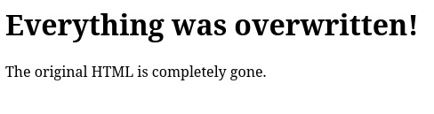
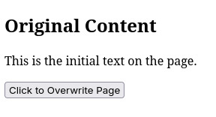
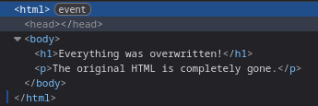
Using document.writeln() after an HTML document is loaded, will delete all existing HTML
Overwrites the page if the doc fully loaded – event
<html>
<body>
<h2>Original Content</h2>
<p>This is the initial text on the page.</p>
<button onclick="overwritePage()">Click to Overwrite Page</button>
<script>
function overwritePage() {
document.writeln("<h1>Everything was overwritten!</h1>");
document.writeln("<p>The original HTML is completely gone.</p>");
}
</script>

Slide 16
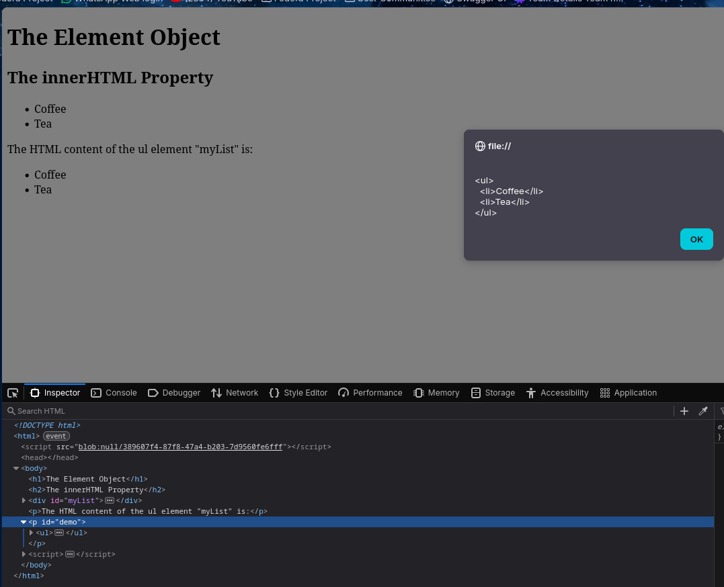
innerHTML – HTML marksup inside element (tags included) as a string.
Deletes everything inside the element and replaces it
<!DOCTYPE html>
<html>
<body>
<h1>The Element Object</h1>
<h2>The innerHTML Property</h2>
<div id="myList">
<ul >
<li>Coffee</li>
<li>Tea</li>
</ul>
</div>
<p>The HTML content of the ul element "myList" is:</p>
<p id="demo"></p>
<script>
let html = document.getElementById("myList").innerHTML;
document.getElementById("demo").innerHTML = html;
alert(html);
</script>
</body>
</html>

Slide 17
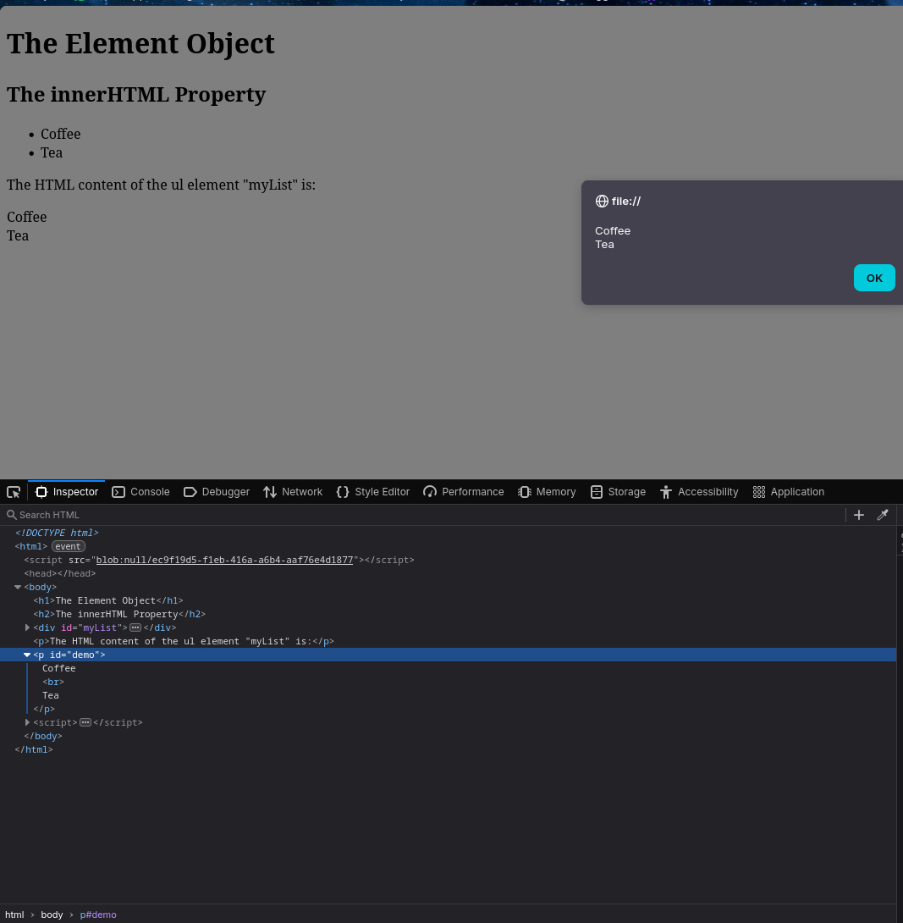
innerText – Human visible text only inside element (tags are stripped) as a string.
Deletes everything inside and replaces it with plain text
<html>
<body>
<div id="myList">
<ul >
<li>Coffee</li>
<li>Tea</li>
</ul>
</div>
<p>The HTML content of the ul element "myList" is:</p>
<p id="demo">This is Naren</p>
<script>
let text = document.getElementById("myList").innerText;
document.getElementById("demo").innerText = text;
alert(text);
</script>
</body>
</html>

Slide 18
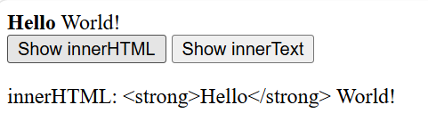
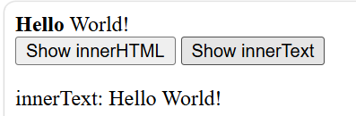
innerHTML and innerText are both used to get or set the content of an HTML element, but they behave differently.
<body>
<div id="demo">
<strong>Hello</strong> World!
</div>
<button onclick="showInnerHTML()">Show innerHTML</button>
<button onclick="showInnerText()">Show innerText</button>
<p id="output"></p>
<script>
function showInnerHTML() {
const content = document.getElementById("demo").innerHTML; document.getElementById("output").textContent = "innerHTML: " + content;
}
function showInnerText() {
const content = document.getElementById("demo").innerText; document.getElementById("output").textContent = "innerText: " + content;
}
</script>

Slide 19
JavaScript is a dynamically typed language, meaning variables are not bound to a specific data type.
Instead, the type is associated with the value stored in the variable and is determined at runtime. This flexibility allows variables to hold different types of data at different points in the program.
For example:
let x = 42; // x is a number
console.log(x); // Output: 42
x = "hello"; // x is now a string
console.log(x); // Output: hello
x = [1, 2, 3]; // x is now an array
console.log(x); // Output: [1, 2, 3]

Slide 20
Key Features of Dynamic Typing in JavaScript
No Explicit Type Declaration: Unlike statically typed languages like Java or C++, you don't need to declare the type of a variable. The type is inferred based on the value assigned.
Type Coercion: JavaScript automatically converts values between types when necessary. For instance:
let x = 5 + "5"; // Number 5 is coerced into a string
console.log(x); // Output: "55"
Flexible Function Arguments: Functions in JavaScript can accept arguments of any type without requiring explicit type definitions:
function print(x) {
console.log(x);
}
print(42); // Output: 42
print("hello"); // Output: hello
print({ key: "val" }); // Output: { key: 'val' }
Advantages and Considerations
Dynamic typing makes JavaScript easier to program and more flexible, especially for rapid development. However, it can lead to runtime errors if type mismatches occur, and it may be slower compared to statically typed languages.
For developers seeking more type safety, TypeScript is a superset of JavaScript that introduces static typing, enabling better error detection during development.

Slide 21
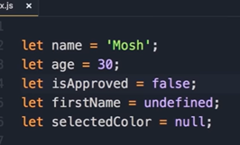
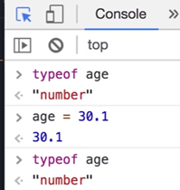
Variables
undefined and null are two special values in JavaScript
They both represent the absence of a value, but they are used differently.

Slide 22
undefined
A variable has the value undefined when it has been declared but has not been assigned a value.
Example 1
let age;
console.log(age);
Output
Undefined
---------------------------------------------
The variable age exists.
No value has been assigned to it.
JavaScript automatically gives it the value undefined.

Slide 23
Example 2
A function that doesn't return anything returns undefined.
function greet() {
console.log("Hello");
}
let result = greet();
console.log(result);
Output
Hello
undefined

Slide 24
null
null means there is intentionally no value.
It is a value that you assign yourself.
Example
let user = null;
console.log(user);
Output
null
This means:
"Currently, there is no user."
Another example:
let selectedItem = null;
This means no item is selected yet.

Slide 25
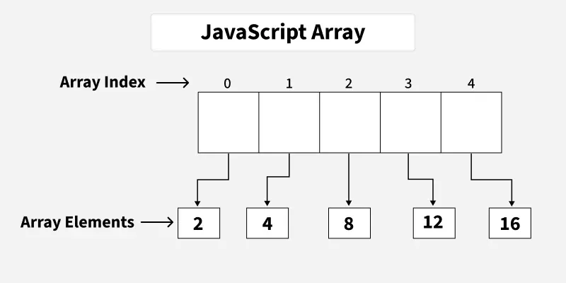
In JavaScript, an array is an ordered list of values. Each value, known as an element, is assigned a numeric position in the array called its index.
The indexing starts at 0, so the first element is at position 0, the second at position 1, and so on.
Arrays can hold any type of data-such as numbers, strings, objects, or even other arrays-making them a flexible and essential part of JavaScript programming.

Slide 26
// Creating an Array and Initializing with Values
let b = [10, 20, 30];
console.log(b);
// Creating and Initializing an array with values
let a = new Array(10, 20, 30);
console.log(a);
// Creating an Array and Initializing with Values
let a = ["HTML", "CSS", "JS"];
// Accessing Array Elements
console.log(a[0]);
console.log(a[1]);

Slide 27
Accessing the Last Element of an Array
We can access the last array element using [array.length - 1] index number.
// Creating an Array and Initializing with Values
let a = ["HTML", "CSS", "JS"];​
// Accessing Last Array Elements
let lst = a[a.length - 1];​
console.log("Last Item: ", lst);
Modifying the Array Elements
Elements in an array can be modified by assigning a new value to their corresponding index.
// Creating an Array and Initializing with Values
let a = ["HTML", "CSS", "JS"];
console.log(a);
​a[1]= "Bootstrap";
console.log(a);

Slide 28
Adding Elements to the Array
Elements can be added to the array using methods like push() and unshift().
The push() method add the element to the end of the array.
The unshift() method add the element to the starting of the array.
// Creating an Array and Initializing with Values
let a = ["HTML", "CSS", "JS"];​
// Add Element to the end of Array
a.push("Node.js");​
// Add Element to the beginning
a.unshift("Web Development");​
console.log(a);

Slide 29
Removing Elements from an Array
To remove the elements from an array we have different methods like pop(), shift(), or splice().
The pop() method removes an element from the last index of the array.
The shift() method removes the element from the first index of the array.
The splice() method removes or replaces the element from the array.
// Creating an Array and Initializing with Values
let a = ["HTML", "CSS", "JS"];
console.log("Original Array: " + a);
​// Removes and returns the last element
let lst = a.pop();
console.log("After Removing the last: " + a);​
// Removes and returns the first element
let fst = a.shift();
console.log("After Removing the First: " + a);​
// Removes 2 elements starting from index 1
a.splice(1, 2);
console.log("After Removing 2 elements starting from index 1: " + a);

Slide 30
Increase and Decrease the Array Length
We can increase and decrease the array length using the JavaScript length property.
// Creating an Array and Initializing with Values
let a = ["HTML", "CSS", "JS"]​
// Increase the array length to 7
a.length = 7;​
console.log("After Increasing Length: ", a);​
// Decrease the array length to 2
a.length = 2;
console.log("After Decreasing Length: ", a)

Slide 31
Array Concatenation
Combine two or more arrays using the concat() method. It returns new array containing joined arrays elements.
// Creating an Array and Initializing with Values
let a = ["HTML", "CSS", "JS", "React"];
let b = ["Node.js", "Express.js"];​
// Concatenate both arrays
let concateArray = a.concat(b);​
console.log("Concatenated Array: ", concateArray);
Conversion of an Array to String
We have a built-in method toString() to converts an array to a string.
// Creating an Array and Initializing with Values
let a = ["HTML", "CSS", "JS"];​
// Convert array ot String
console.log(a.toString());

Slide 32
Check the Type of an Arrays
The JavaScript typeof operator is used to check the type of an array. It returns "object" for arrays.
// Creating an Array and Initializing with Values
let a = ["HTML", "CSS", "JS"];​
// Check type of array
console.log(typeof a);

Slide 33
JavaScript arrays can store values of different data types in the same array. This is possible because JavaScript is a dynamically typed language
Output
[
100,
"John",
true,
null,
undefined,
{ city: "Chennai" },
[10, 20],
function() { return "Hello"; }
]
20
Hello
let data = [
100, // Number
"John", // String
true, // Boolean
null, // Null
undefined, // Undefined
{ city: "Chennai" }, // Object
[10, 20], // Array
function() { // Function
return "Hello";
}
];
console.log(data);
console.log(data[6][1]); // 20
console.log(data[7]()); // Hello
Representing real-world data
Suppose you want to store information about a student.
let student = [
101,
"Alice",
89.5,
true
];

Slide 34
In JavaScript, objects are collections of properties, where a property is an association between a name (or key) and a value. These values can be functions, in which case the property is known as a method. There are several ways to create objects in JavaScript, each with its own use cases and advantages.
Using Object Literals
The simplest way to create an object is by using an object literal. This method involves defining an object with a list of name-value pairs inside curly braces {}. For example:
const person = {
firstName: "John",
lastName: "Doe",
age: 50,
eyeColor: "blue"
};
This creates an object person with properties firstName, lastName, age, and eyeColor.
JavaScript objects are versatile and powerful tools for organizing and managing data.

Slide 35
How to add method in Object Literal method of creating object?
const person = {
firstName: "John",
lastName: "Doe",
age: 50,
eyeColor: "blue",
fullName: function() {
return this.firstName + " " + this.lastName;
}
};
console.log(person.fullName()); // John Doe
fullName is a method.
this refers to the current object (person).

Slide 36
Using the new Object() Syntax
Another way to create an object is by using the new Object() syntax.
const person = new Object();
person.firstName = "John";
person.lastName = "Doe";
person.age = 50;
person.eyeColor = "blue";
// Adding a method
person.fullName = function() {
return this.firstName + " " + this.lastName;
};
console.log(person.fullName()); // John Doe
This achieves the same result as the object literal method but is more verbose.

Slide 37
Using Constructor Functions
Constructor functions allow you to create multiple instances of an object type. This is useful when you need to create many similar objects. A constructor function is defined using the function keyword and is typically named with a capital letter:
function Car(make, model, year) {
this.make = make;
this.model = model;
this.year = year;
}
const myCar = new Car("Eagle", "Talon TSi", 1993);
const kensCar = new Car("Nissan", "300ZX", 1992);
In this example, Car is a constructor function that creates car objects with properties make, model, and year.

Slide 38
Using the Object.create() Method
The Object.create() method allows you to create a new object with a specified prototype. This method is useful for creating objects that inherit properties and methods from another object:
const Animal = {
type: "Invertebrates",
displayType() {
console.log(this.type);};
}
const animal1 = Object.create(Animal);
animal1.displayType();
const fish = Object.create(Animal);
fish.type = "Fishes";
fish.displayType(); // Logs: Fishes
In this example, animal1 and fish are created with Animal as their prototype.
Accessing and Modifying Object Properties
You can access and modify object properties using dot notation or bracket notation:
console.log(person.firstName);
console.log(person["lastName"]);
person.age = 51;
person["eyeColor"] = "green";

Slide 39
JavaScript objects are dynamic, which means you can add, modify, or remove properties and methods even after the object has been created.
Add data members after creating an object?
const person = {
firstName: "John",
age: 25
};
person.city = "Chennai";
person.country = "India";
console.log(person);
Output
{
firstName: "John",
age: 25,
city: "Chennai",
country: "India"
}

Slide 40
Add methods after creating an object?
const person = {
firstName: "John",
lastName: "Doe"
};
person.fullName = function() {
return this.firstName + " " + this.lastName;
};
console.log(person.fullName());
Output
John Doe
Modify existing properties
const person = {
age: 25
};
person.age = 30;
console.log(person.age);
Output
30
Delete properties
const person = {
name: "John",
age: 25
};
delete person.age;
console.log(person);
Output
{ name: "John" }

Slide 41
JavaScript functions serve as reusable blocks of code that can be called from anywhere within your application.
They eliminate the need to repeat the same code, promoting code reusability and modularity.
function name(arguments)
{
javascript statements
}
function welcome() {
console.log("welcome to GfG");
}
// Function calling
welcome();

Slide 42
1. Named function:
A Named function is one that we write in code and then use whenever we need it by referencing its name and providing it with some parameters. Named functions come in handy when we need to call a function several times to give various values to it or run it multiple times.
function add(a, b) {
return a + b;
}
console.log(add(5, 4));
2. Anonymous function:
We can define a function in JavaScript without giving it a name. This nameless function is referred to as the Anonymous function. A variable must be assigned to an anonymous function.
let add = function (a, b) {
return a + b;
}
console.log(add(5, 4));

Slide 43
3. Arrow function
const myFunction = (a, b) => a * b;
This is equivalent to:
const myFunction = function(a, b)
{ return a * b;};
const calculateTotal = (price, taxRate) => {
const taxAmount = price * taxRate;
const finalPrice = price + taxAmount;
return finalPrice;
};
console.log(calculateTotal(100, 0.15));

Slide 44
Function Parameters
In JavaScript, functions do not require the number of arguments to exactly match the number of formal parameters.
Number mismatch between argument list and formal parameter list:
More arguments: excess ignored
Fewer arguments: remaining parameters are Undefined
If more arguments are passed than there are formal parameters, the extra arguments are ignored
Example 1: Excess Arguments are Ignored
function add(a, b) {
console.log("a =", a);
console.log("b =", b);
return a + b;
}
let result = add(10, 20, 30, 40);
console.log("Sum =", result);

Slide 45
If fewer arguments are passed than the number of formal parameters, the missing parameters are automatically assigned the value undefined.
Example 1: Fewer Arguments
function add(a, b) {
console.log("a =", a);
console.log("b =", b);
return a + b;
}
let result = add(10);
console.log("Sum =", result);
Output
a = 10
b = undefined
Sum = NaN
JavaScript was designed to be a dynamic and loosely typed language. One of its design goals was to make programming easier and more flexible, especially for scripting web pages. Because of this, JavaScript does not enforce that the number of arguments must match the number of formal parameters.

Slide 46
Arithmetic Operators
Operator | Description
+ | Addition
- | Subtraction
* | Multiplication
** | Exponentiation
/ | Division
% | Modulus (Division Remainder)
++ | Increment
-- | Decrement
Logical Operators
Operator | Description
&& | logical and
|| | logical or
! | logical not

Slide 47
Comparison Operators
Operator | Description | Example
== | equal to | x == 5
=== | equal value and equal type | x === 5
!= | not equal | x != 5
!== | not equal value or not equal type | x !== 5
> | greater than | x > 5
< | less than | x < 5
>= | greater than or equal to | x >= 5
<= | less than or equal to | x <= 5

Slide 48
console.log(first + " " + last);
console.log(first.concat(" ", last));
//Template Literals
let name = "John";
let age = 25;
console.log(`My name is ${name} and I am ${age} years old.`);
Creation of strings
let str1 = "Hello";
let str2 = 'World';
str1.length
console.log(str[3]);
console.log(str.charAt(2));
console.log(str.at(-1));
let str = "Hello";
str[0] = "Y";
console.log(str);
Output
Hello
Strings cannot be modified
directly.
let text = "Hello world!";
let result = text.repeat(2);
let text = "Please visit Microsoft!";
let newText = text.replace("Microsoft", "W3Schools");
By default, the replace() method is case sensitive. Writing MICROSOFT (with upper-case) will not work:
Example
let text = "Please visit Microsoft!";
let newText = text.replace("MICROSOFT", "W3Schools");

Slide 49
Extracting String Parts
There are 3 methods for extracting a part of a string:
slice(start, end)
substring(start, end)
substr(start, length)
let part = text.slice(7, 13); // from 7 to 13
let part = text.slice(7); // from 7 to remaining
let part = text.slice(-12); // pos. counted from end
let part = text.slice(-12, -6); // from -12 to -6
substring() is similar to slice().
The difference is that start and end values less than 0 are treated as 0 in substring().
substr() is similar to slice().
The difference is that the second parameter specifies the length of the extracted part.
let part = str.substr(7, 6);

Slide 50
let text = "Please locate where 'locate' occurs!";
let index = text.indexOf("locate");
The lastIndexOf() method returns the index of the last occurrence of a specified text in a string:
Example
let text = "Please locate where 'locate' occurs!";
let index = text.lastIndexOf("locate");
Both indexOf(), and lastIndexOf() return -1 if the text is not found:

Slide 51
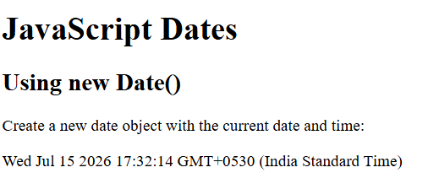
<!DOCTYPE html>
<html>
<body>
<h1>JavaScript Dates</h1>
<h2>Using new Date()</h2>
<p>Create a new date object with the current date and time:</p>
<p id="demo"></p>
<script>
const d = new Date();
document.getElementById("demo").innerText = d;
</script>
</body>
</html>

Slide 52
<html>
<body>
<h2>Digital Clock</h2>
<p id="clock"></p>
<script>
function showTime()
{
var d = new Date();
var h = d.getHours();
var m = d.getMinutes();
var s = d.getSeconds();
document.getElementById("clock").innerText =
h + ":" + m + ":" + s;
}
showTime(); // Display the current time
setInterval(showTime, 1000); // Update every second
</script>
</body>
</html>

Slide 53
What is JSON?
JSON (JavaScript Object Notation) is a lightweight data interchange format used to store and exchange data between applications.
Although JSON is derived from JavaScript object syntax, it is a language-independent
JavaScript Object
const person = {
name: "John",
age: 25,
city: "Chennai"
};
JSON
{
"name": "John",
"age": 25,
"city": "Chennai"
}
Example of JSON
{
"name": "John",
"age": 25,
"city": "Chennai",
"isStudent": false
}
JavaScript Object JSON
Keys may be quoted or unquoted Keys must be enclosed in double quotes
Can contain functions Cannot contain functions
Used inside JavaScript programs Used for data exchange
Supports comments (in code) Comments are not allowed

Slide 54
JSON.parse() converts a JSON string into a JavaScript object.
Suppose you receive the following JSON data from a server:
let data = '{"name":"John","age":25}';
Notice that data is a string, not an object.
console.log(typeof data);
Output
String
To use the values (name, age), convert the string into a JavaScript object:
let person = JSON.parse(data);
console.log(person.name);
console.log(person.age);
Output
John
25

Slide 55
let student = {
rollNo: 101,
name: "Anita",
department: "CSE"
};
let jsonData = JSON.stringify(student);
console.log(jsonData);
console.log(typeof jsonData);
Output
{"rollNo":101,"name":"Anita","department":"CSE"}
string

